Slide 1
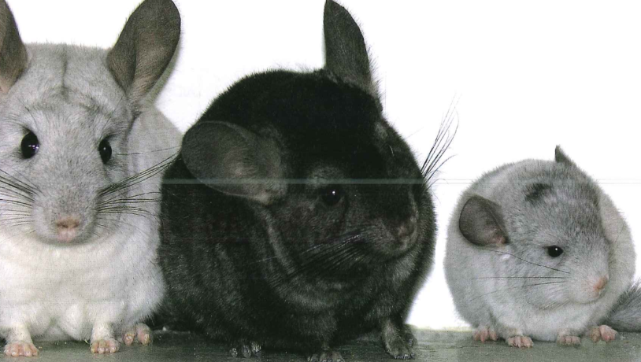
Inheritance
inheritance 遗传

Slide 2
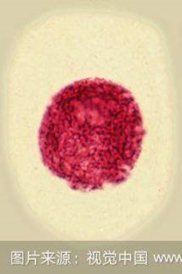
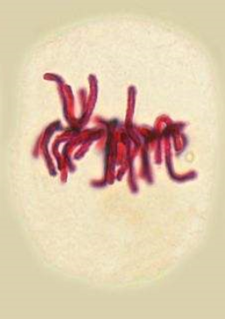
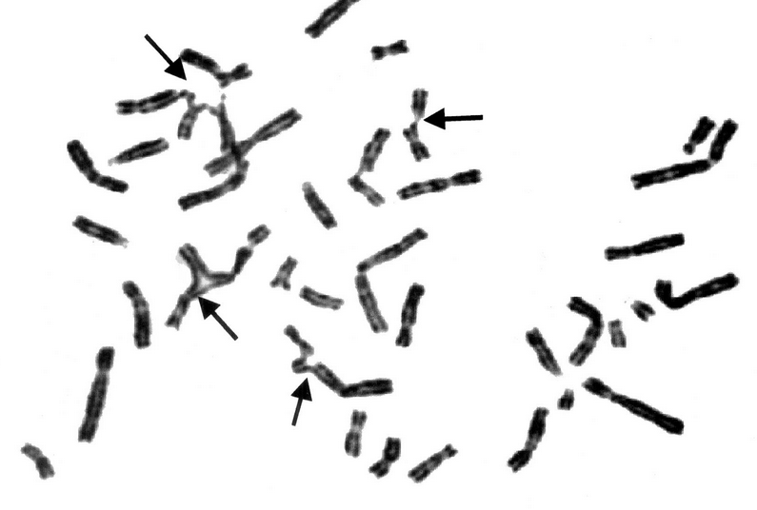
Inheritance
chromosomes
Notes:
视频

Slide 3
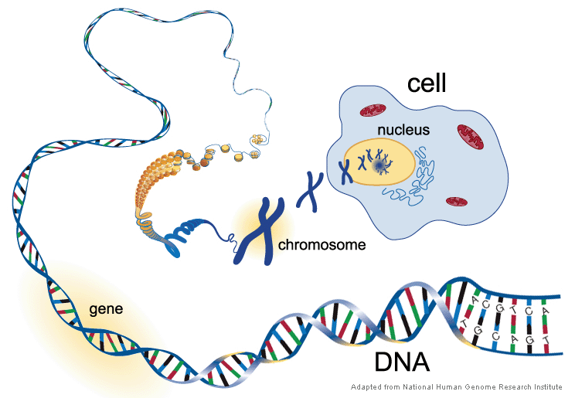
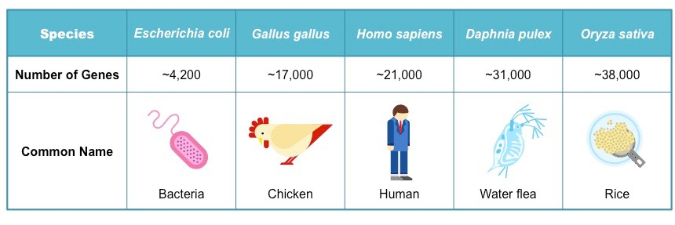
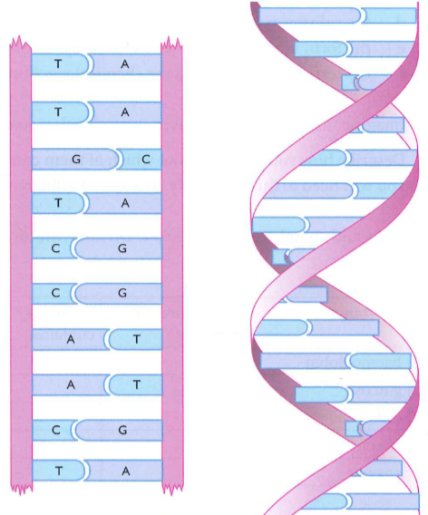
Inheritance
chromosomes
Gene
A length of DNA that codes for a protein
Genes determine all sorts of things about you
Notes:
视频

Slide 4
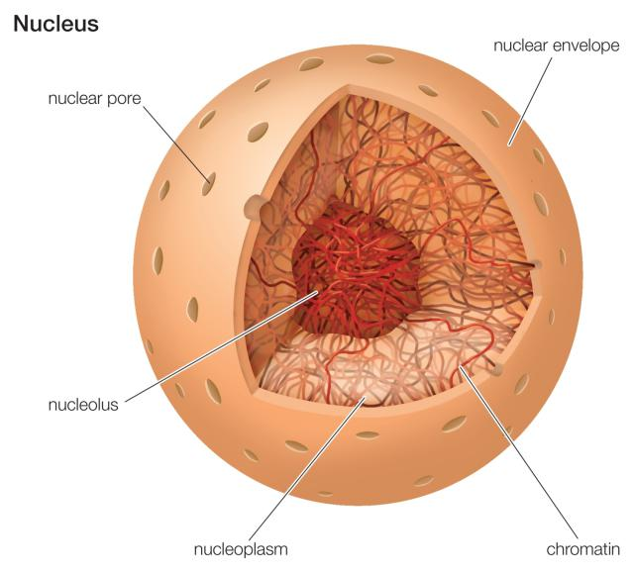
Inheritance
chromosomes
Chromosome
a thread-like structure of DNA, carrying genetic information in the form of genes.
genetic information
遗传信息

Slide 5
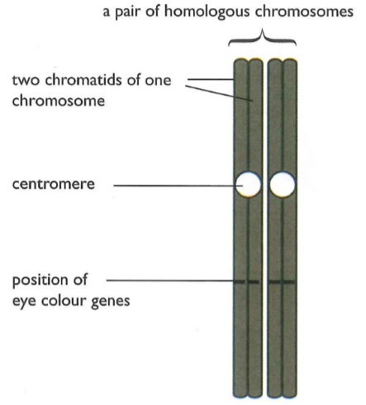
Inheritance
Inheritance
Each chromosome in a homologous pair contains genes for the same characteristic in the same positions.
allele
Any of two or more alternative forms of a gene
We refer to these alleles using letters as symbols
allele 等位基因
letter 字母

Slide 6
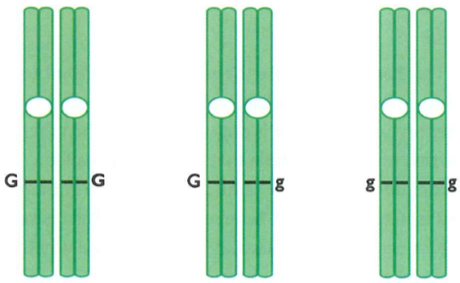
Inheritance
Inheritance
homozygous
Have two identical alleles of a particular gene (e.g. GG or gg). Two homozygous individuals that breed together will be pure/true-breeding纯种繁殖.
heterozygous
Having two different alleles of a particular gene ( Gg), not pure-breeding.
homozygous 纯合子的
heterozygous 杂合子的

Slide 7
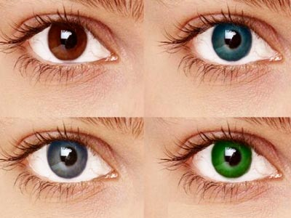
Inheritance
inheritance
Genotype
genetic make-up of an organism in terms of the alleles present (e.g. TT or mm).
phenotype
The observed features of an organism
genotype 基因型
phenotype 表现型
Notes:
视频

Slide 8
Inheritance
inheritance
Dominant alleles
An allele that is expressed if it is present (e.g. G)
recessive alleles
An allele that is only expressed when there is no dominant allele of the gene present (e.g. g)
dominant 显性的
recessive 隐性的
Notes:
视频

Slide 9
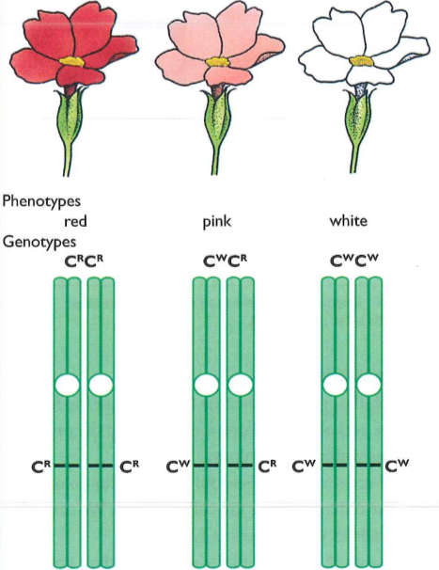
Inheritance
inheritance
codominance alleles
neither of a pair of alleles is completely dominant or completely recessive. They both have an effect on the phenotype.
Co-dominance is the type of dominance where the offspring show similarity to both the parents and it is due to the blending混合 of alleles.
codominant 共显的
codominance 共显性

Slide 10
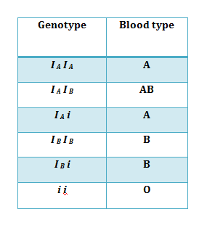
Inheritance
inheritance
ABO blood group antigen
I^{A} produces antigen A on the surface of red blood cells
I^{B} produces antigen B on the surface of red blood cells
I^{O} produces no antigen.
I^{A} I^{B} I^{O}
Alleles I^{A} and I^{B} are codominant, but both are dominant to I^{O} .
blood group 血型
antigen 抗原

Slide 11
The allele for brown eyes is dominant to the allele for blue eyes. Write down suitable symbols for these alleles
What is the phenotype of a person who is heterozygous for this characteristics?
What is codominance?
Alleles of the gene for the ABO blood group antigens in humans show two unusual characteristics. What are these?
Write down all the possible genotypes and phenotypes fro blood goups?

Slide 12
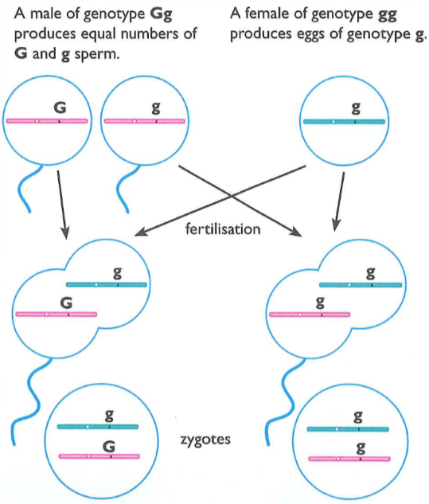
Inheritance
inheritance
Alleles in gametes
Genes and fertilization
The chances of diffusion by each kinds of sperms with egg are equal.

Slide 13
3b – Inheritance – Genetics
Monohybrid Cross单基因杂交
“A monohybrid cross is the hybrid of two individuals with homozygous genotypes for a certain genetic trait.”
“The cross between two monohybrid traits (TT and tt) is called a Monohybrid Cross.”
You need to be able to draw genetic diagrams and predict the probability of certain phenotypes in the offspring.
We use a diagram called a punnett square to show this.
Notes:
亲本为纯合且只有一个等位基因不同的杂交

Slide 14
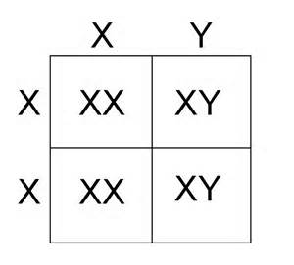
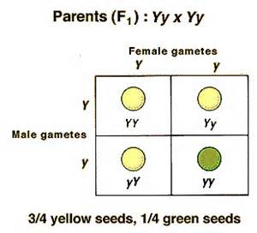
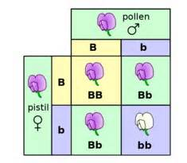
Genetic Diagrams – Punnett Squares 3.18 describe patterns of monohybrid inheritance using a genetic diagram
SOME SIMPLE EXAMPLES OF WHAT YOU CAN USE A PUNNETT SQUARE FOR
SEED COLOUR
FLOWER COLOUR
GENDER
press

Slide 15
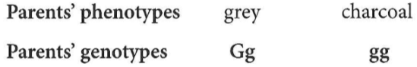
Inheritance
Genetic diagrams
Genetic diagram
grey
 | G | g
g | Gg | gg
1/2
genetic diagram 遗传图解
charcoal
1/2

Slide 16
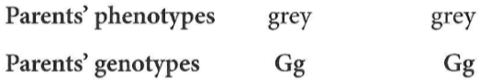
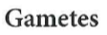

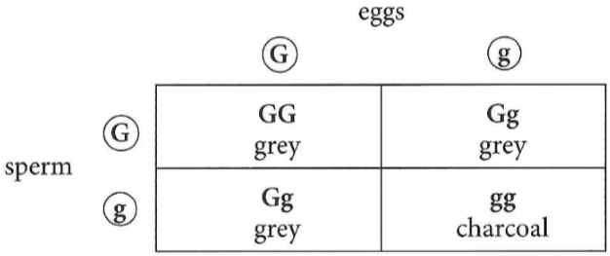
Inheritance
Genetic diagrams
Genetic diagram
Notes:
画方块

Slide 17
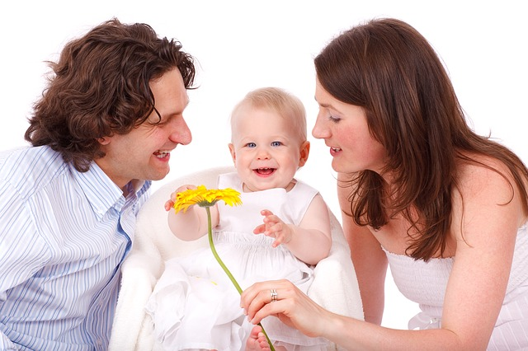
3b – Inheritance – Genetics
Monohybrid Cross – Worked example
A man and a woman both have brown eyes, what are the chances that they will have a baby with blue eyes?
A monohybrid cross should always be laid out as shown on the following slide.
Showing the cross between the parents’ phenotype, genotype and and possible gametes. Then the punnett square and finally the offspring’s genotypes and phenotypes.

Slide 18
3b – Inheritance – Genetics
Monohybrid Cross – Worked example
A man is heterozygous for brown eyes and he mates with a woman who is heterozygous for brown eyes, what percentage of their children will have blue eyes?
Father
Mother
The allele for brown is dominant and blue is recessive.
Parents Phenotype:
Brown
x
Brown
Parents Genotype:
Bb
x
Bb
b
B
b
b
B
B
b
Parents gametes:
B
Punnett Square:
BB
Bb
Bb
bb
Offspring’s genotypes:
1 x BB, 2 x Bb, 1 x bb
Answer:
25%
Offspring’s phenotypes:
¾ Brown ¼ Blue

Slide 19

3b – Inheritance – Genetics
Monohybrid Cross – Practice questions
The allele for rolling your tongue is dominant over the allele for not being able to roll your tongue.
A man who is homozygous for tongue rolling and a woman who is heterozygous for tongue rolling have children.
What percentage will not be able to roll their tongue?

Slide 20
3b – Inheritance – Genetics
Monohybrid Cross – Practice questions
A man who is homozygous for tongue rolling and a woman who is heterozygous for tongue rolling have children. What percentage will not be able to roll their tongue?
Father
Mother
Parents Phenotype:
Tongue Roller
x
Tongue Roller
Parents Genotype:
TT
x
Tt
t
T
t
T
T
T
T
Parents gametes:
T
Punnett Square:
mother
father
TT
Tt
TT
Tt
Offspring’s genotypes:
2 x TT, 2 x Tt
Answer:
0%
Offspring’s phenotypes:
All tongue rollers

Slide 21

3b – Inheritance – Genetics
Monohybrid Cross – RULES!
Always use the same letter for the two alleles but use upper case for the dominant allele and lower case for the recessive.
When you show breeding use a X.
Put gametes and genotypes in circles.
Show all the possible outcomes.
Give answers as a ratio or percentage.

Slide 22
Inheritance
Test crosses
An organism that shows a dominant characteristic, what is it possible genotypes?
Test cross
Cross an individual with the unknown for a particular gene with one known to have the homozygous recessive genotype for the same gene.
test crosses 测交

Slide 23
TEST CROSS 3.18 describe patterns of monohybrid inheritance using a genetic diagram
Geneticists use the test cross to determine unknown Genotypes
A testcross can reveal an unknown genotype
Mate an individual of unknown genotype and a homozygous-recessive individual
In a test cross you breed an organism showing the dominant features with one showing the recessive feature
Each of the two possible genotypes (homozygous or heterozygous) gives a different phenotypic ratio in the F1 generation

Slide 24
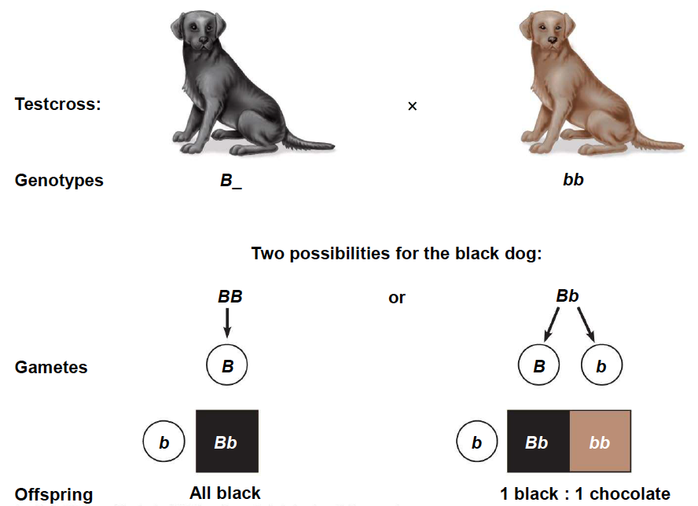
TEST CROSS 3.18 describe patterns of monohybrid inheritance using a genetic diagram

Slide 25
Pedigree Charts系谱图 3.19 understand how to interpret family pedigrees
A pedigree is a chart of the genetic history of family over several generations.
Constructing a Pedigree
Connecting Pedigree Symbols
Female
Married Couple
Siblings
Male
Not Affected
Affected
Deceased
Fraternal twins
Identical twins

Slide 26
Example (Dominant or Recessive) 3.19 understand how to interpret family pedigrees
Is the Affected allele Dominant or Recessive?
Affected
Unaffected
aa
AA
aa
aa
RECESSIVE
Aa
Aa
Aa
aa
aa
aa
aa
Aa
Aa
Notes:
Is this pedigree dominant or recessive?

Slide 27
Example (Dominant or Recessive) 3.19 understand how to interpret family pedigrees
Is the Affected allele Dominant or Recessive?
Affected
Unaffected
Aa
aa
Aa
Aa
DOMINANT
Aa
aa
Aa
Aa
AA
aa
AA
aa
Aa
Notes:
Is this pedigree dominant or recessive?

Slide 28
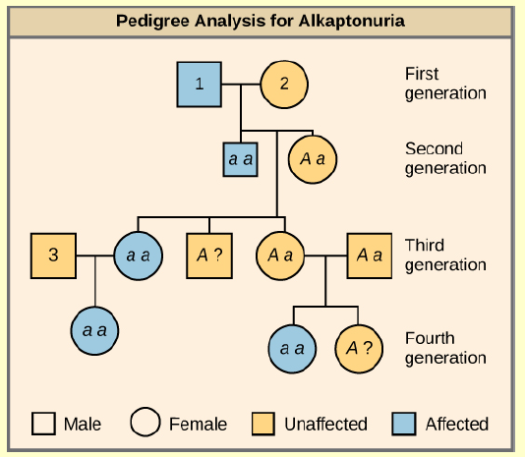
3b – Inheritance – Genetics
Pedigree charts
Can you tell if the affected gene is dominant or recessive?
You can tell it is recessive from the information in the pedigree.
If it was dominant than all three children in the 3rd generation would have been affected.
Can you work out what the genotypes would be for 1,2 and 3?

Slide 29
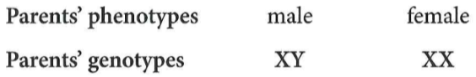
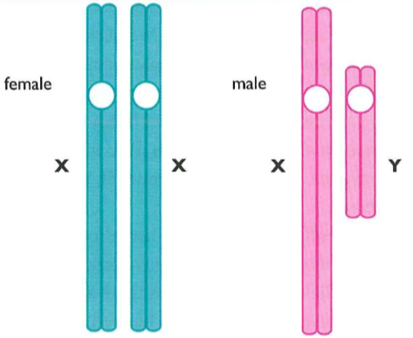
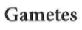
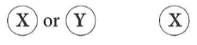
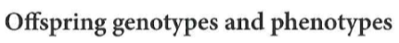
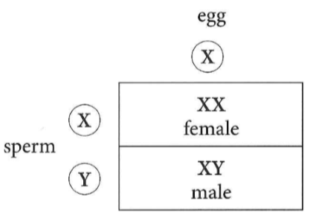
Inheritance
Sex determination
Sex determination
sex determination 性别决定

Slide 30
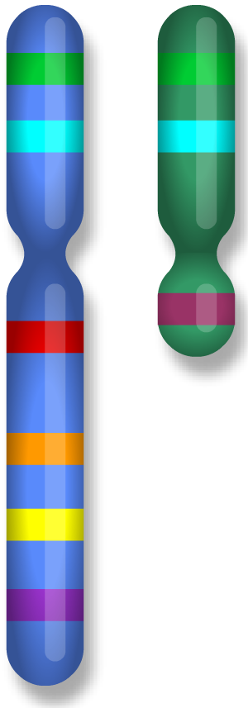
Inheritance
Sex linkage
Sex linkage
Genes that are found only on the non-homologous parts of the X or Y chromosomes are called sex-linked genes.
homologous regions do not carry sex-determining genes
Sex-linked characteristic
non-homologous regions carry sex-determining genes and other genes
A characteristic in which the gene responsible is located on a sex chromosome, which makes it more common in one sex than in the other.
sex linkage 伴性遗传

Slide 31
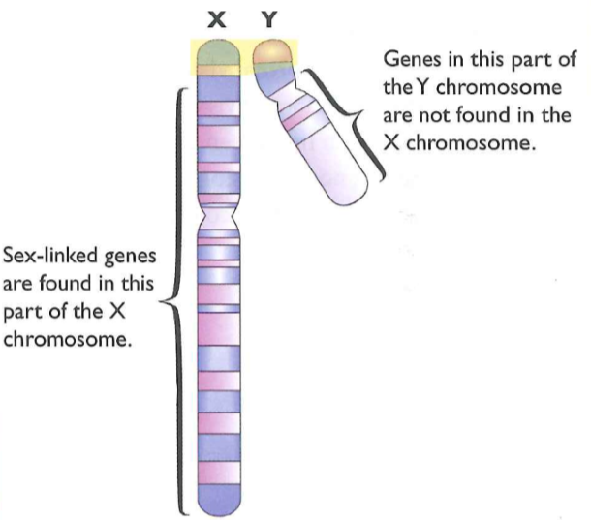
Inheritance
Sex linkage
red-green colour-blind
One of these sex-linked genes controls the production of the three different kinds of cone cells in the retina.
A recessive allele of this gene, b, results in only two types of cone cell being made.
red-green colour-blind 红绿色盲
Notes:
书写

Slide 32
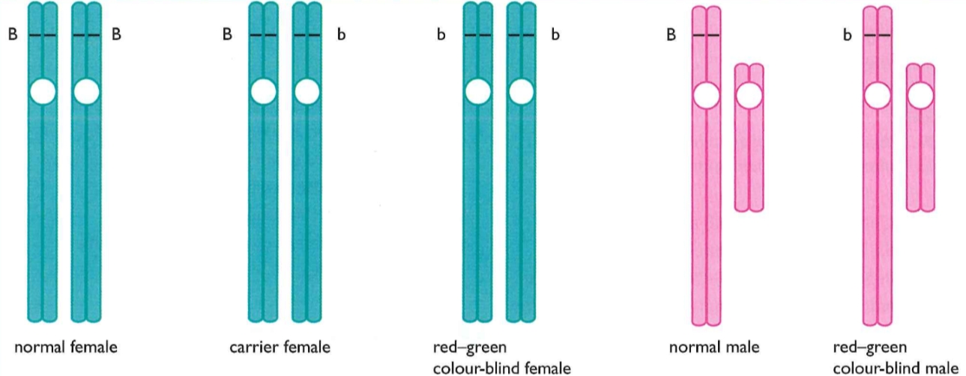
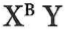
Inheritance
Sex linkage
Red-green colour-blind is much more common in men than in women.
red-green colour-blind
Notes:
书写

Slide 33
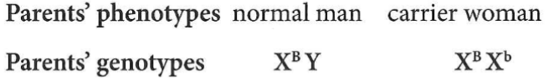
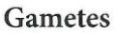
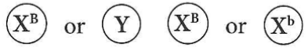
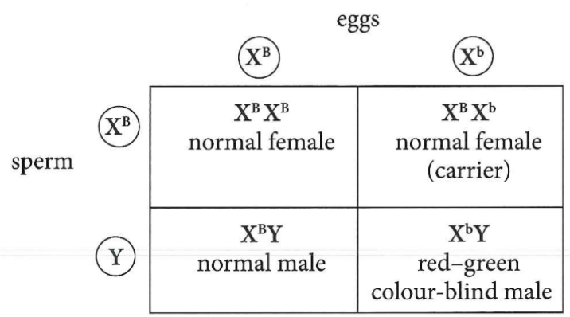
Inheritance
Sex linkage
red-green colour-blind
Notes:
书写

Slide 34


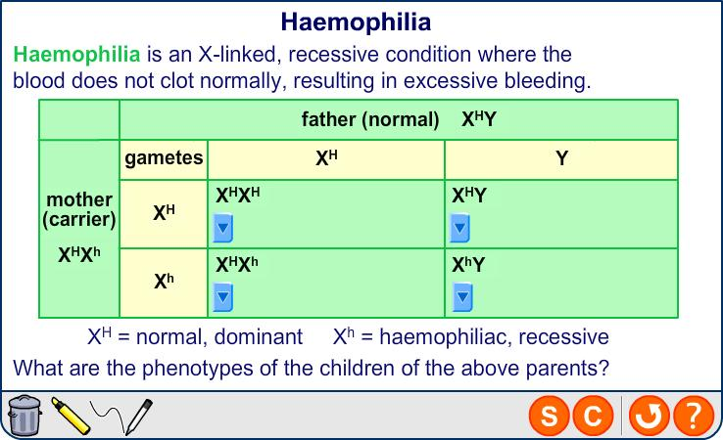

Sex linkage: haemophilia
Notes:
Teacher notes
There are several types of haemophilia:
people with haemophilia A, the most common type (about 90% of cases), are missing clotting factor VIII
people with haemophilia B are missing clotting factor IX
people with haemophilia C are missing clotting factor XI
Boardworks A2 Biology
Inheritance

Slide 35
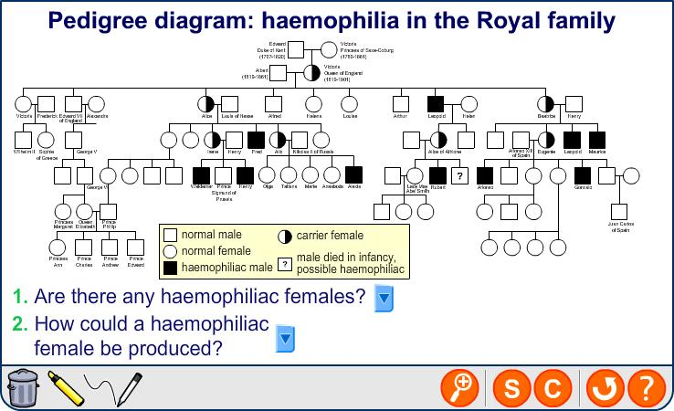
Haemophilia in the Royal Family
Notes:
Boardworks A2 Biology
Inheritance

Slide 36
Inheritance
Sex linkage
A man who is red-green colour-blind marries a woman with normal vision. What is the chance that the couple’s next child will be a colour-blind boy?
Notes:
书写

Slide 37




3b – Inheritance – Genetics
CONCEPT CHECK – True or false?
An allele is a version of a gene
There are 23 pairs of chromosomes in a human cell
Dominant alleles have a capital letter
Homozygous individuals have different alleles for a gene
The genotype is the characteristic expressed
The phenotype is the combination of alleles
Males have an X and Y chromosome
You use a Punnett square to combine alleles in a diagram
Pedigree charts show the family history of a characteristic
Most characteristics are coded for by one gene

